Slide 1
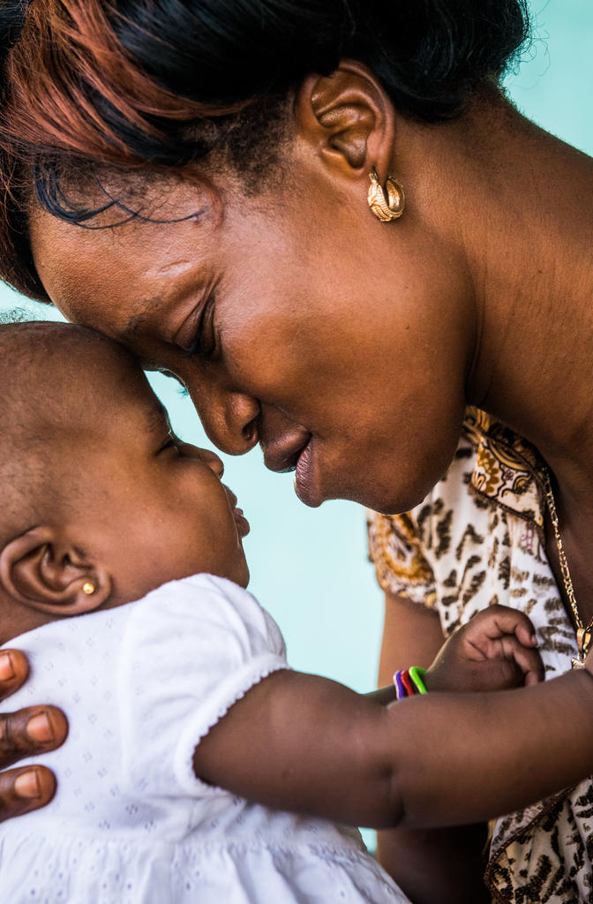

Nurturing care through PHC
Nuhu Yaqub WHO
17 June 2026
Photo credit: © UNICEF/UN0185843/Tremeau

Slide 2
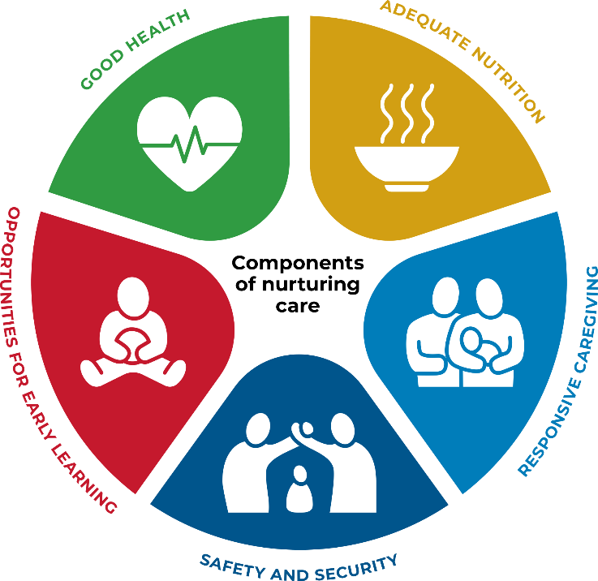

Two core concepts to drive the agenda
What the child’s brain and body
expects and needs
Enabling environments for nurturing care

Slide 3

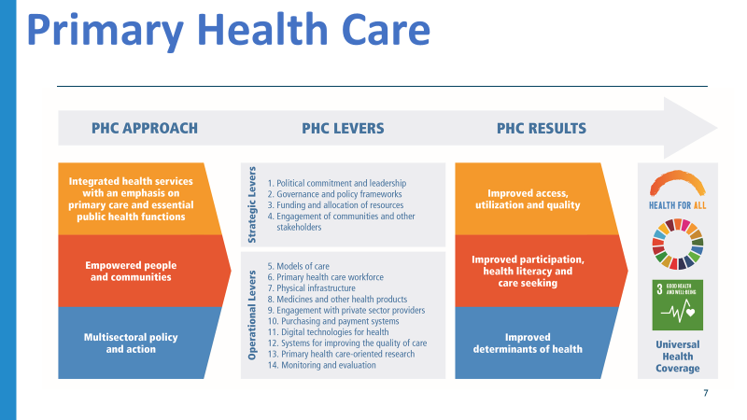

Slide 4



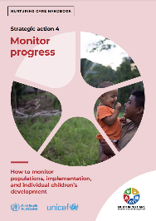
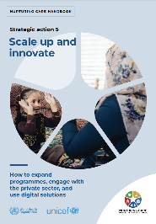
The five strategic actions aligned with the PHC levers
Lead and invest | Governance Planning Financing
Focus on families and their communities | Community engagement Community accountability Using media
Strengthen services | System strengthening Building workforce capacities Strengthening services
Monitor progress | Monitoring individual children Monitoring programme implementation Measuring coverage at population-level
Scale up and innovate | Towards scale Private sector Digital solutions
https://nurturing-care.org/handbook

Slide 5
Gaps within PHC for supporting nurturing care
Core gap: nurturing care is often treated as an add-on — not a routine, facility-level PHC function supported by financing, workforce systems, referrals, family support and data.
Health system capacity
Families, communities and accountability
Governance and financing
• NC not consistently embedded in routine care visits, and facilities to provide services.
• Health workers capabilities, time and confidence to counsel caregivers.
• Data and evidence to monitor progress
• Nurturing care is not consistently included in PHC benefits packages or financing discussions.
• Coordination across sectors and between levels of government weak.
• Families and communities rarely involved in the design of policies and programmes
• Limited data weakens accountability for advocacy, scale and equity

Slide 6


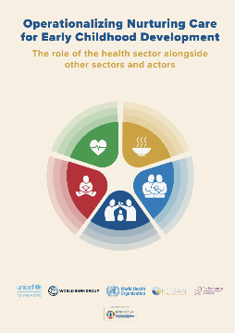

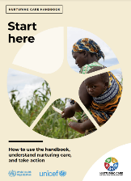





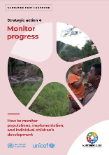

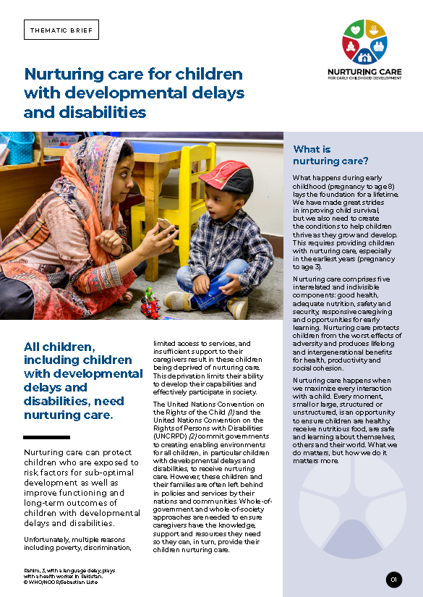

Resources to support operationalization in PHC
Planning and implementing the 5 strategic actions
Strengthening services
Nurturing care handbook
Nurturing care thematic briefs
Engaging the health sector alongside other sectors

Slide 7

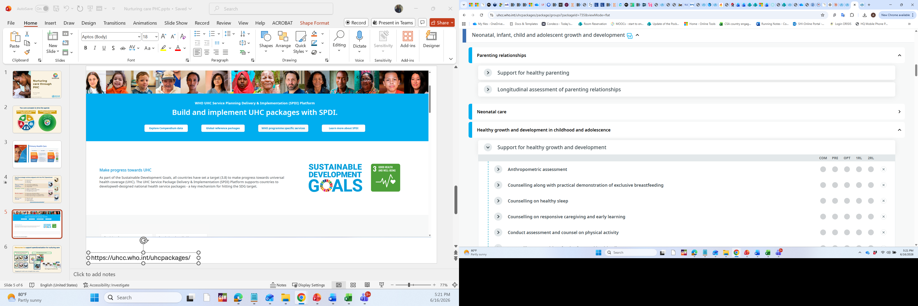
https://uhcc.who.int/uhcpackages/
Notes:
Highlight two upcoming tools

Slide 8

Thank you
For more information:
  nurturing-care.org
  https://www.who.int/teams/primary-health-care
Notes:
Thank you.

